Slide 1
Second Mentor Demo
Pallida Cohort - Static Class
Norbert Szücs – prejunior PLC programmer

Slide 2
Topics covered
void Functions
Arrays[]
Basics
scanf User Input

Slide 3
Guess My Number exercise
Random number generator
Variant to continue or not
Counter for lives

Slide 4
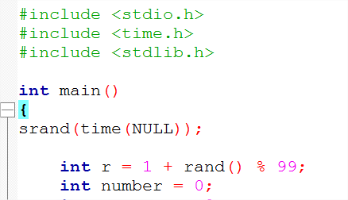
Guess My Number exercise Random number generator

Slide 5

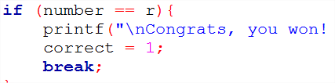
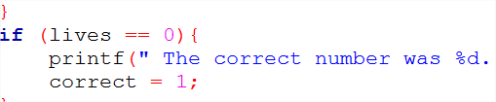
Guess My Number exercise Variant to continue or not

Slide 6
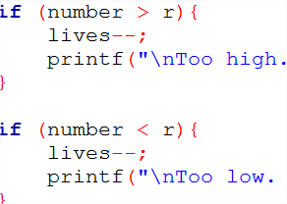
Guess My Number exercise Counter for lives

Slide 7
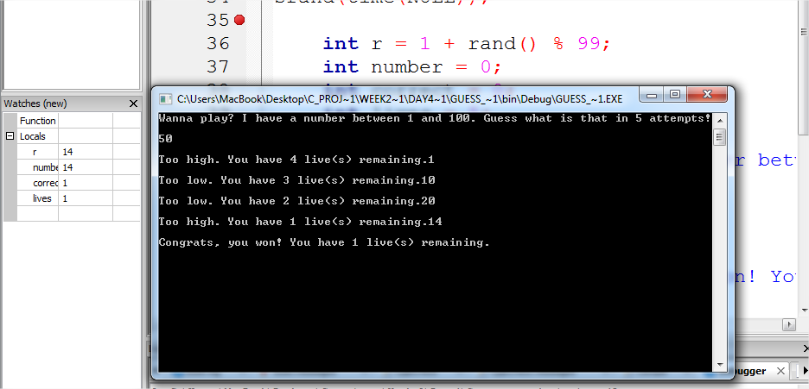
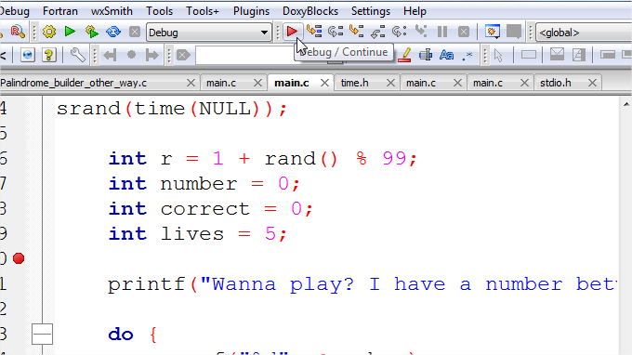
Guess My Number exercise Debugging

Slide 8
Questions?

Slide 9
Thank you for your attention!

